Slide 1

Data Structures
Lecture 11: Binary Search Trees

Slide 2

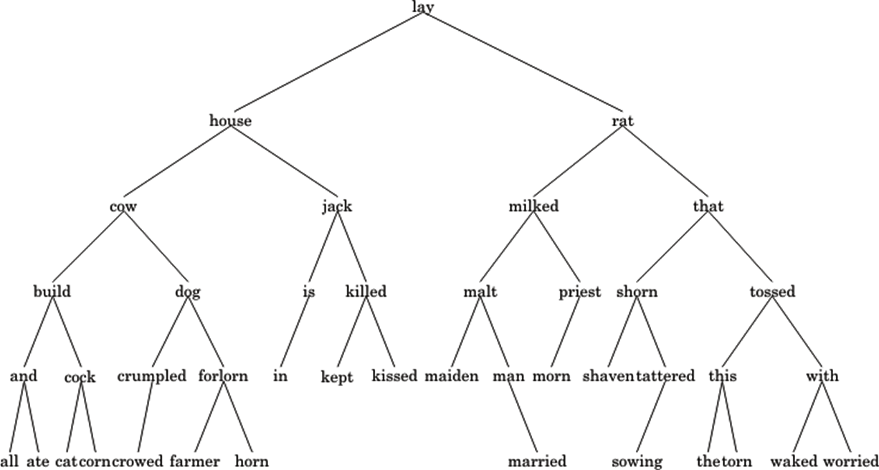
Binary Search Tree (1)
if root is NULL
item not in tree: return NULL
compare target and root->data
if they are equal
target is found, return root->data
else if target < root->data
return search(left subtree)
else
return search(right subtree)
Searching for “kept”

Slide 3
Binary Search Tree (2)
n=42
Searching for “kept” took 5 steps
log(42)= 5.3
O( log n )
But the tree is almost balanced

Slide 4




Efficiency of Binary Search Trees
Max Nodes | Min Nodes | Height
1 | 1 | 1
3 (1+2) | 2 | 2
7 (3+2*2) | 3 | 3
15 (7+2*4) | 4 | 4
Height = 1
Height = 2
Height = 3
Height = 4

Slide 5
Binary Search Tree (3)
n=4
Searching for “fox” took 4 steps
Searching for “fox”
cat
O( n )
cow
dog
In general, the performance is
O( h )
fox

Slide 6
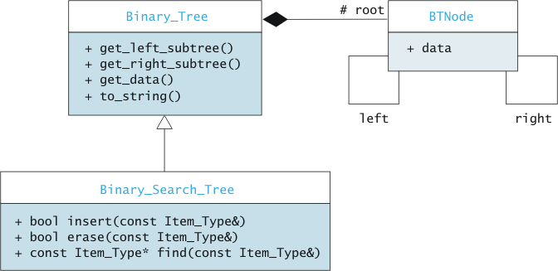
Implementing the Binary Search Tree

Slide 7


Binary Search Tree Functions
Function | Behavior
 | Insert an item into the tree. Returns true if the item was inserted, false if the item was already in the tree.
 | Remove an item from the tree. Returns true if the item was removed, false if the item was not already in the tree.
 | Returns a pointer to an item in the tree, or NULL if the item is not in the tree.
Binary search trees do not allow duplicate keys

Slide 8
Finding an item in a Binary Search Tree (algorithm)
if root is NULL
item not in tree: return NULL
compare target and root->data
if they are equal
target is found, return root->data
else if target < root->data
return search(left subtree)
else
return search(right subtree)
Searching for “kept”

Slide 9
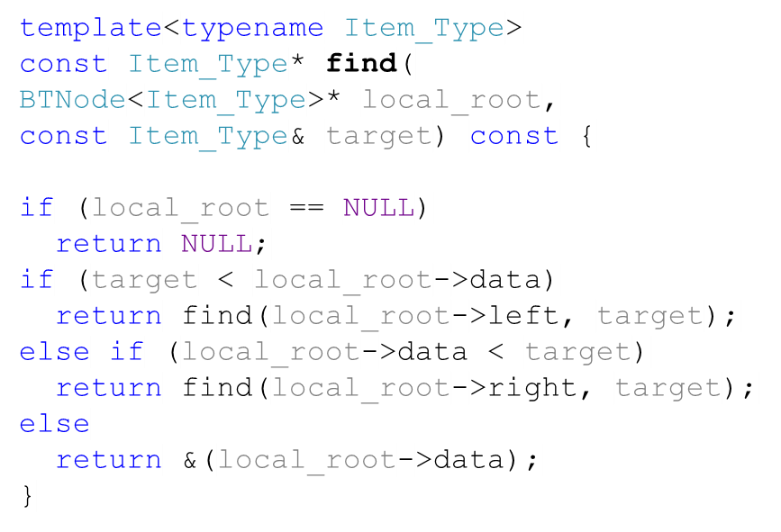
Finding an Item in a Binary Search Tree (code)
Searching for “kept”

Slide 10

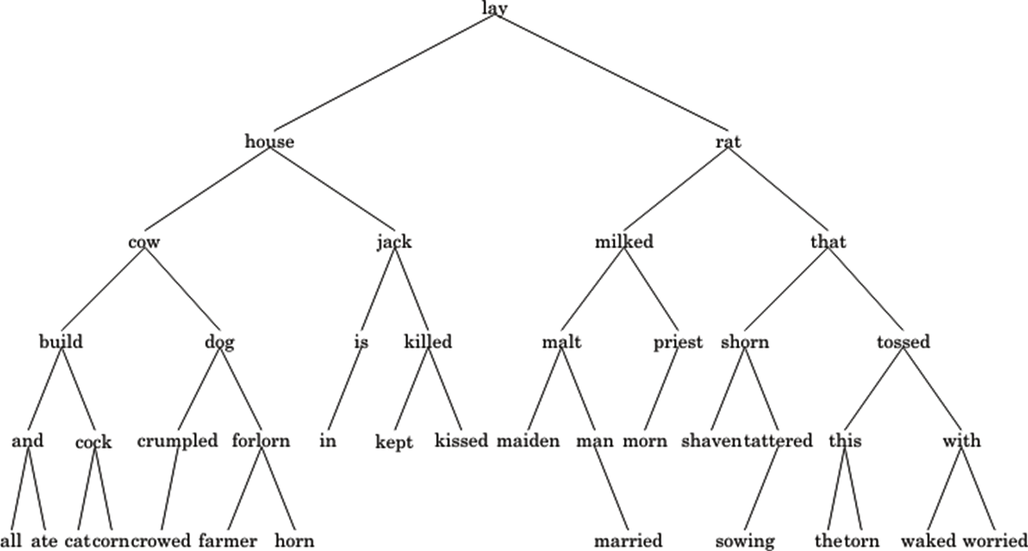
Task
Not in the book
Write functions that calculate the minimum and the maximum of a binary search tree.
Searching for minimum
Searching for maximum

Slide 11
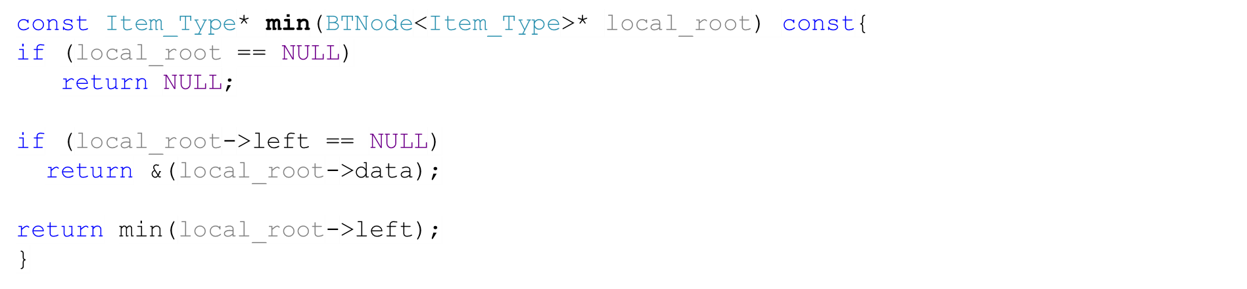

Solution
Not in the book

Slide 12
Task
Not in the book
Write a function that converts a binary search tree into a sorted vector
10
7
20
2
9
30
2 | 7 | 9 | 10 | 20 | 30

Slide 13
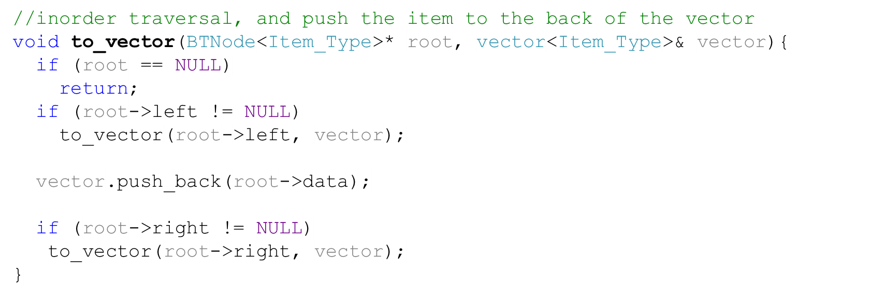
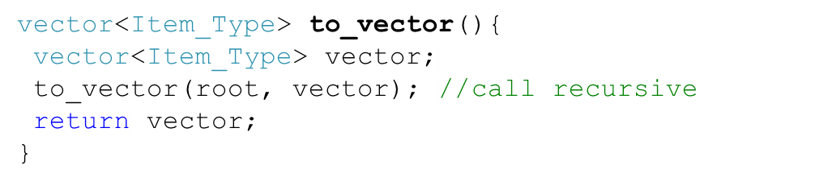
Solution
Not in the book
10
7
20
2
9
30
Wrapper
2 | 7 | 9 | 10 | 20 | 30

Slide 14
Inserting an item into a Binary Search Tree (algorithm)
if root is NULL
replace empty tree with new data leaf; return true
if item equals root->data
return false
if item < root->data
return insert(left subtree, item)
else
return insert(right subtree, item)
Inserting “Jill”
jill

Slide 15
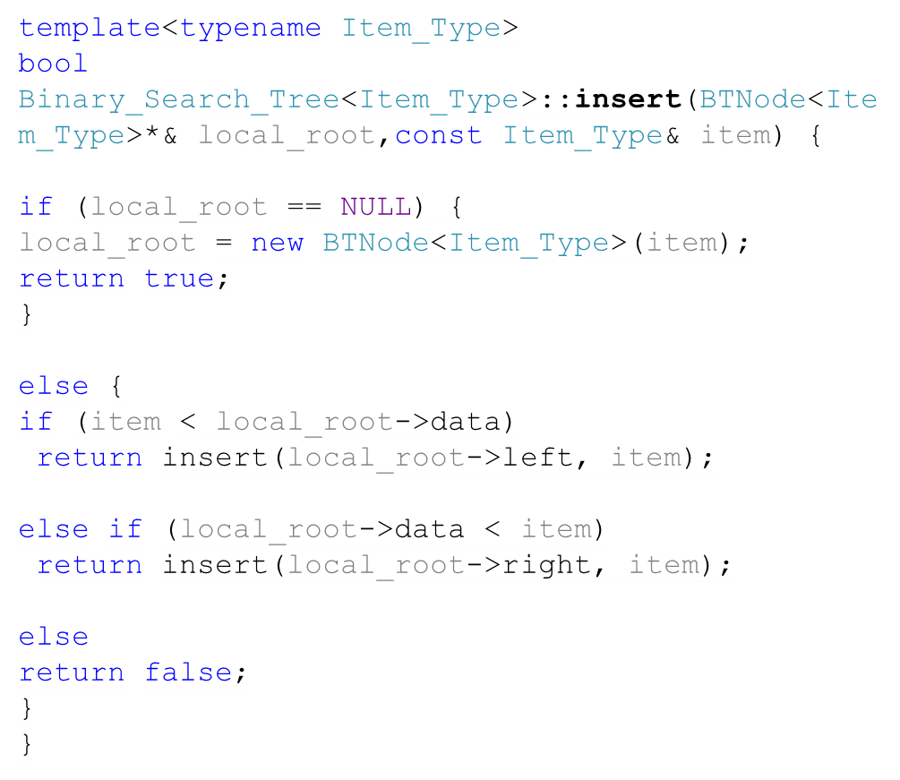
Inserting an item into a Binary Search Tree (code)
Inserting “Jill”
jill

Slide 16
Task
Not in the book
Write a function that converts a sorted vector into a binary search tree
9
2
20
7
10
30
0 | 1 | 2 | 3 | 4 | 5
2 | 7 | 9 | 10 | 20 | 30

Slide 17
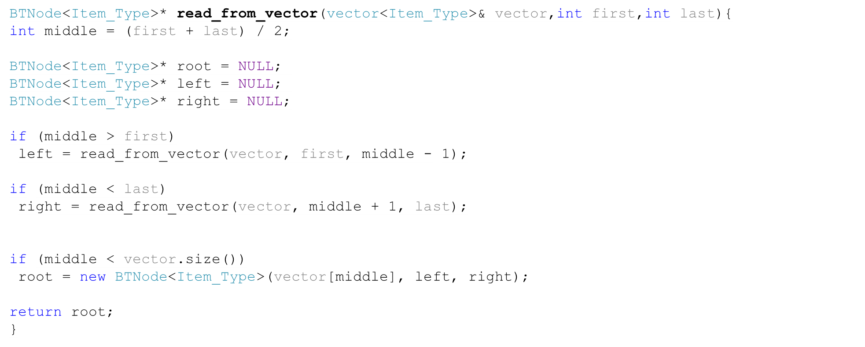
Solution (1)
Not in the book
9
2
20
7
10
30
0 | 1 | 2 | 3 | 4 | 5
2 | 7 | 9 | 10 | 20 | 30

Slide 18
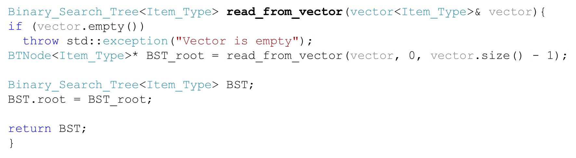
Solution (2)
Not in the book
Wrapper
9
2
20
7
10
30
0 | 1 | 2 | 3 | 4 | 5
2 | 7 | 9 | 10 | 20 | 30

Slide 19
Deleting an item from a Binary Search Tree (algorithm)
● Item not present: do nothing
● Item present in leaf: remove leaf (change to null)
● Item in non-leaf with one child:
  ● Replace current node with that child
● Item in non-leaf with two children?
  Find largest item in the left subtree
  Recursively remove it
  Use it as the parent of the two subtrees

Slide 20
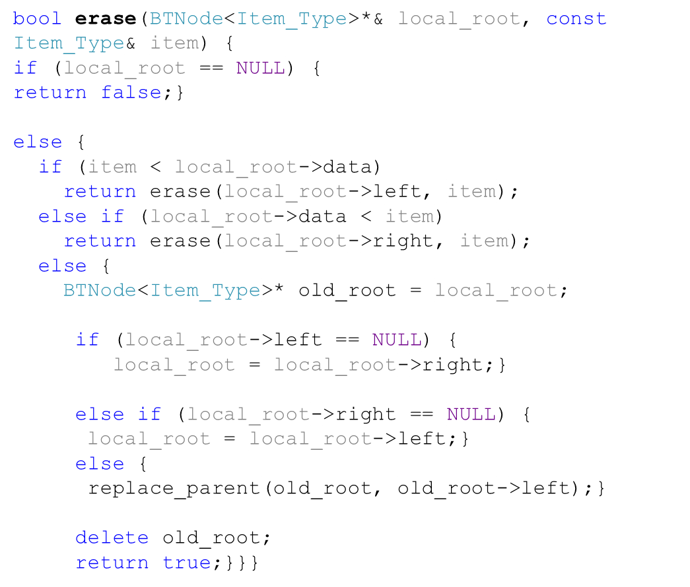
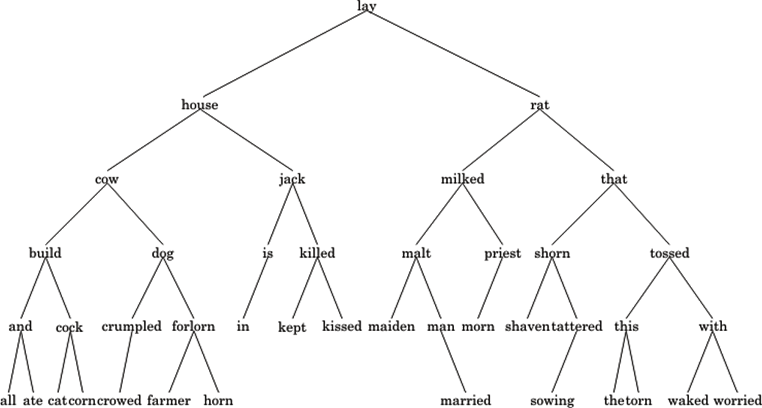
Deleting an item from a Binary Search Tree (code), 1
Case 1: Removing “is”

is
in

Slide 21
Deleting an item from a Binary Search Tree (code), 2
Case 2: Removing “house”
house

Slide 22
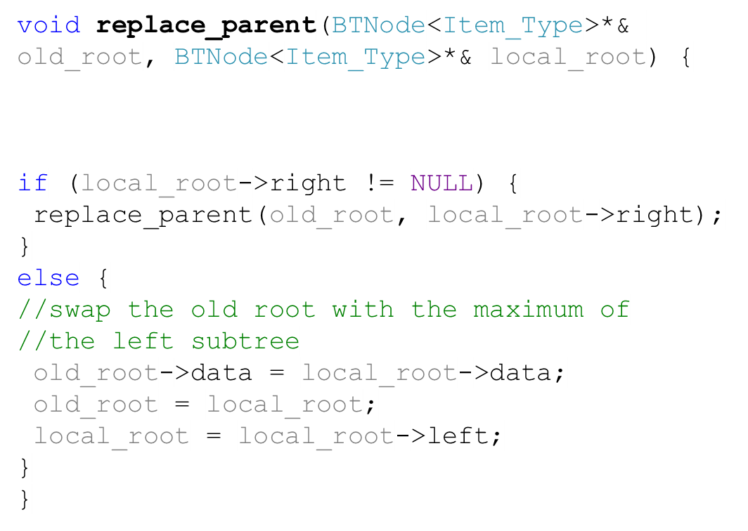
Deleting an item from a Binary Search Tree (code), 3
Case 2: Removing “house”

horn
house
horn

Slide 23
Task
Not in the book
Write a function that updates the key of a node in a binary search tree. For instance, what should happen if we want to set the node with key =9 to key = 14 instead.
10
7
15
6
9
13
20
11

Slide 24
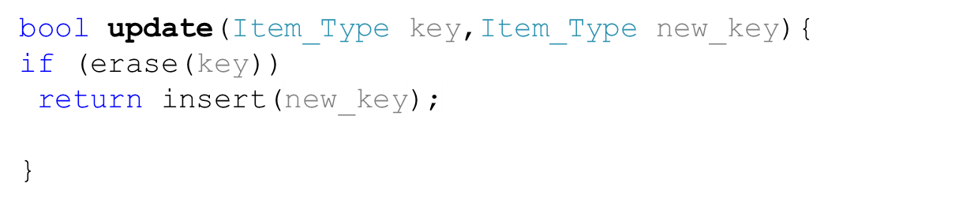
Solution
Not in the book
10
7
15
2
9
13
20
11

Slide 25
Task
Not in the book
Write a function that returns all the items in the tree that start with a given string. For instance, given the word “c”, your function should return a list of these words: cow, coach, cat, corn, crumpled, crowed.
coach

Slide 26
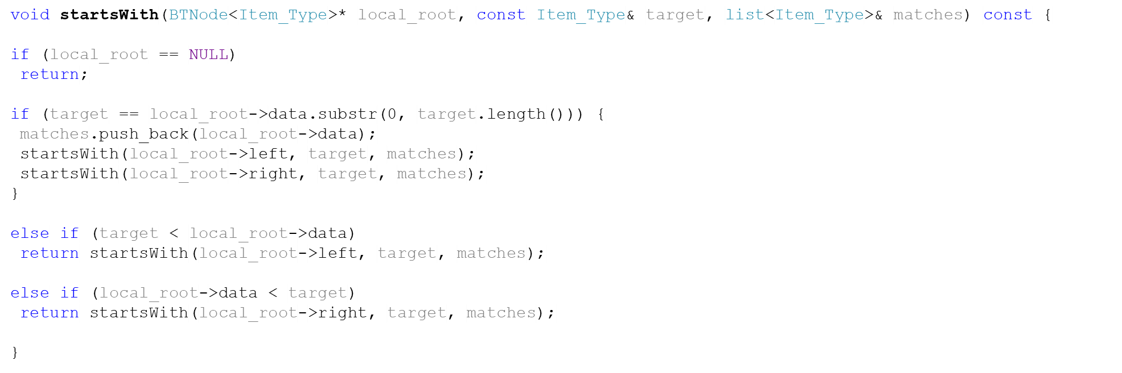
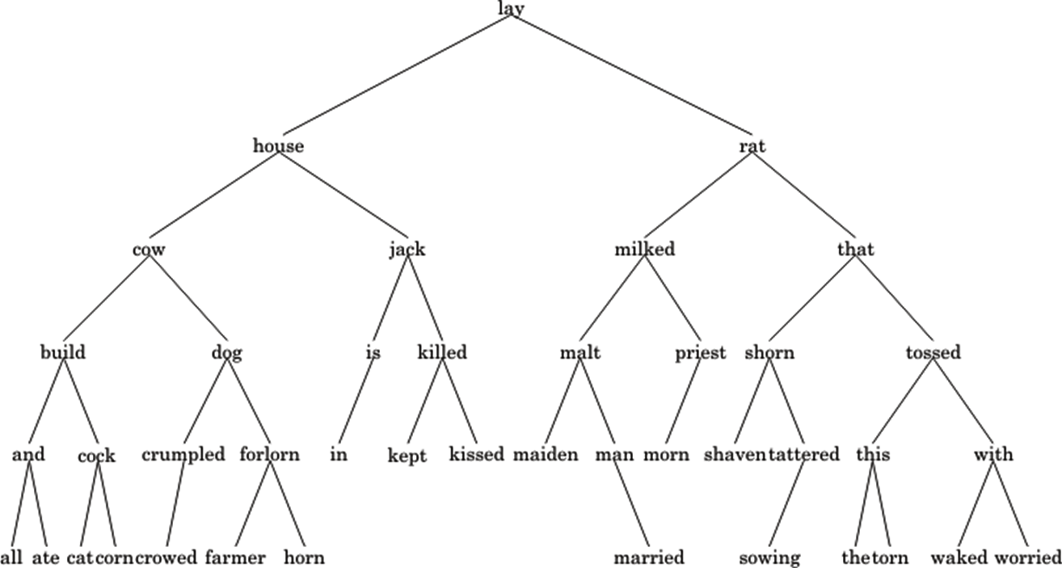
Task - Solution (1)
Not in the book
coach

Slide 27
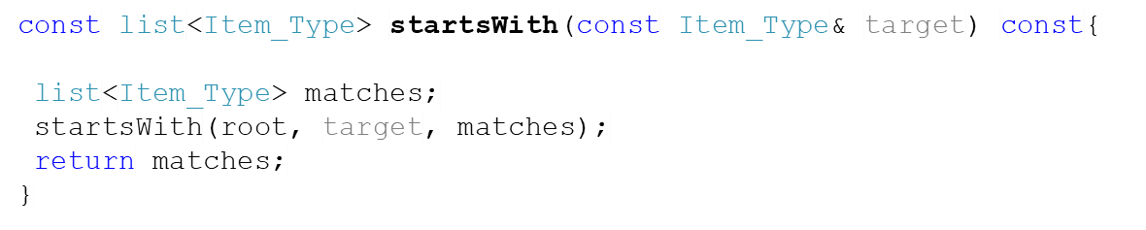
Task - Solution (2)
Not in the book
Wrapper
coach

Slide 28
Writing an Index for a Term Paper
The index should show each word in the paper followed by the line number in which it has occurred.
a, 3
a, 13
are, 3
We would like to display the indexes in ascending order.

Slide 29
Solution to Term Paper Index Problem
We can store the indices in a binary search tree.
We can use the inorder traversal to display the indexes in ascending order.

Slide 30
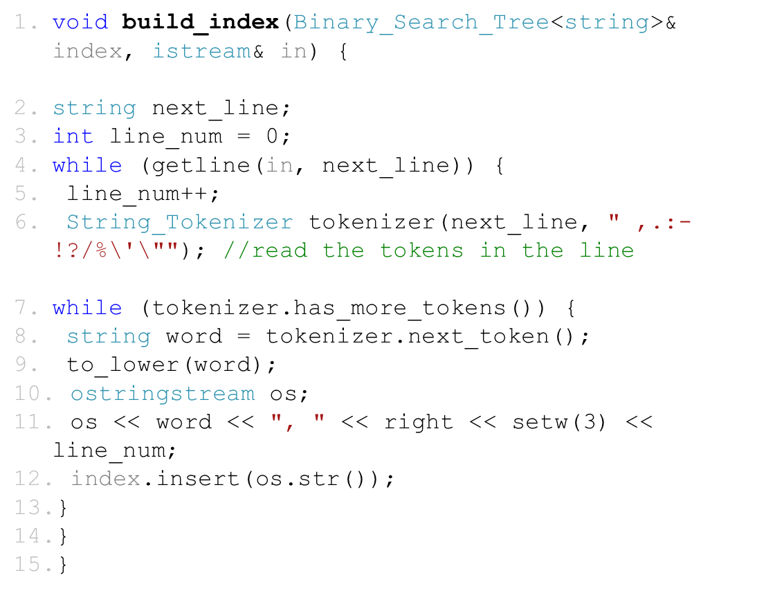
Building Index Algorithm
car, 1
app, 1
mouse, 3
book, 2
job, 3
ninja, 4
cake, 3
car app \n book \n mouse job cake \n ninja

Slide 31
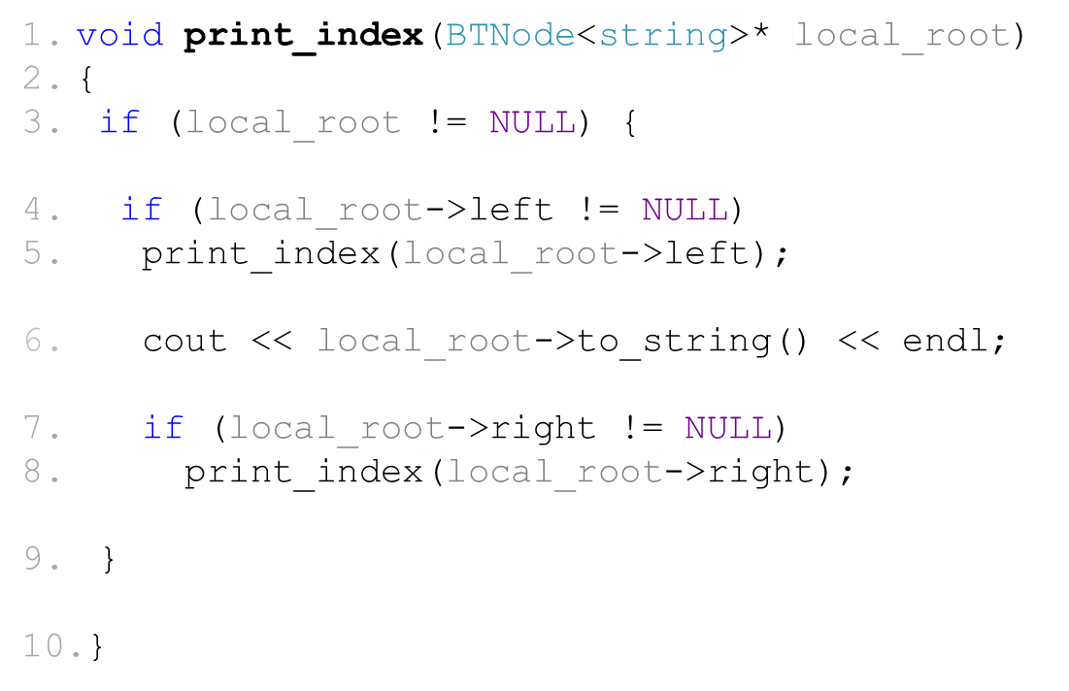
Printing Index Algorithm
car, 1
app, 1
mouse, 3
book, 2
job, 3
ninja, 4
cake, 3
app, 1
mouse, 3
book, 2
ninja, 4
cake, 3
car, 1
job, 3

Slide 32
Term Index Tree Performance
On average, inserting an element is O (log n)
The worst case scenario is when the array is sorted. Inserting an element then is O(n).
a
b
c

